Slide 1

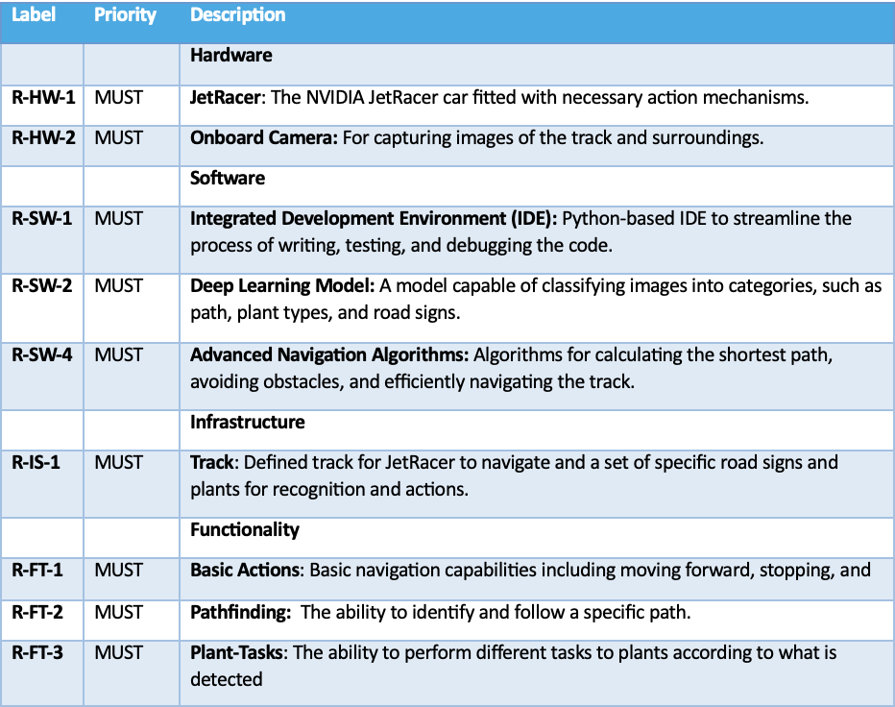
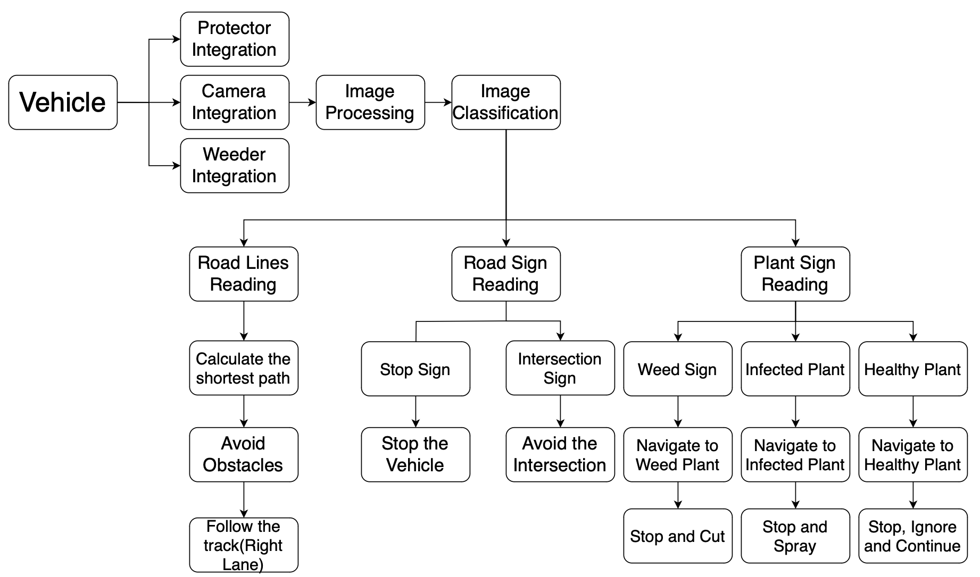
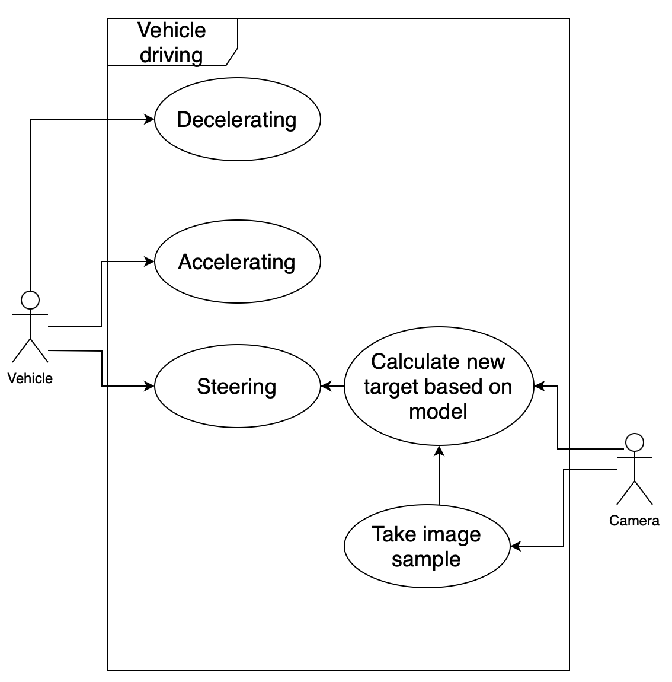
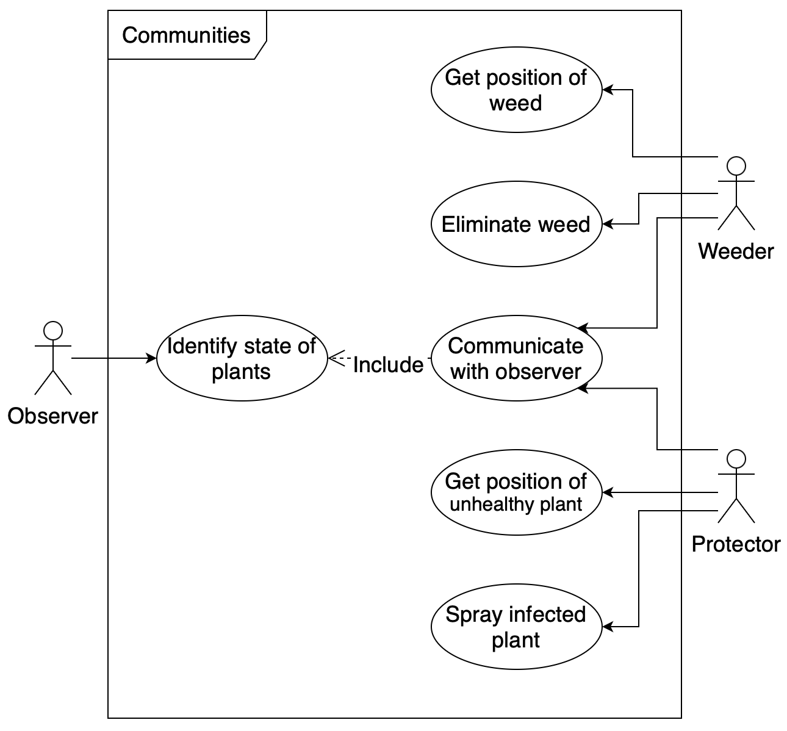
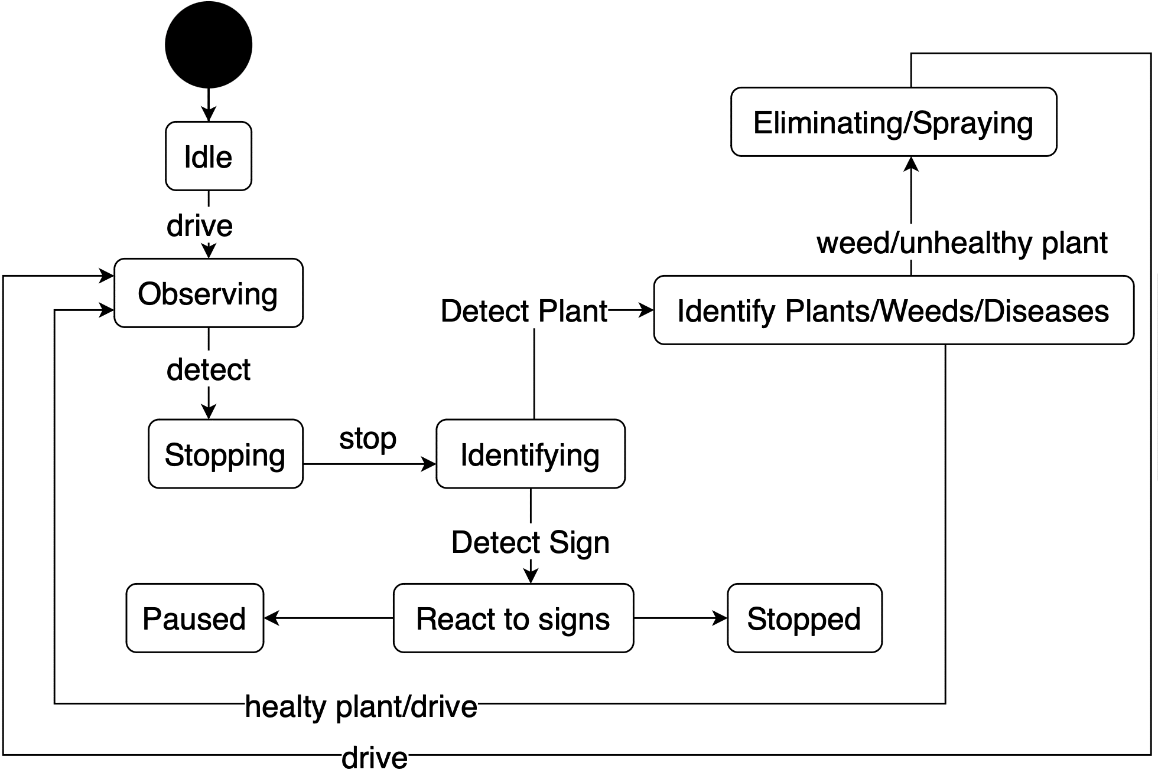
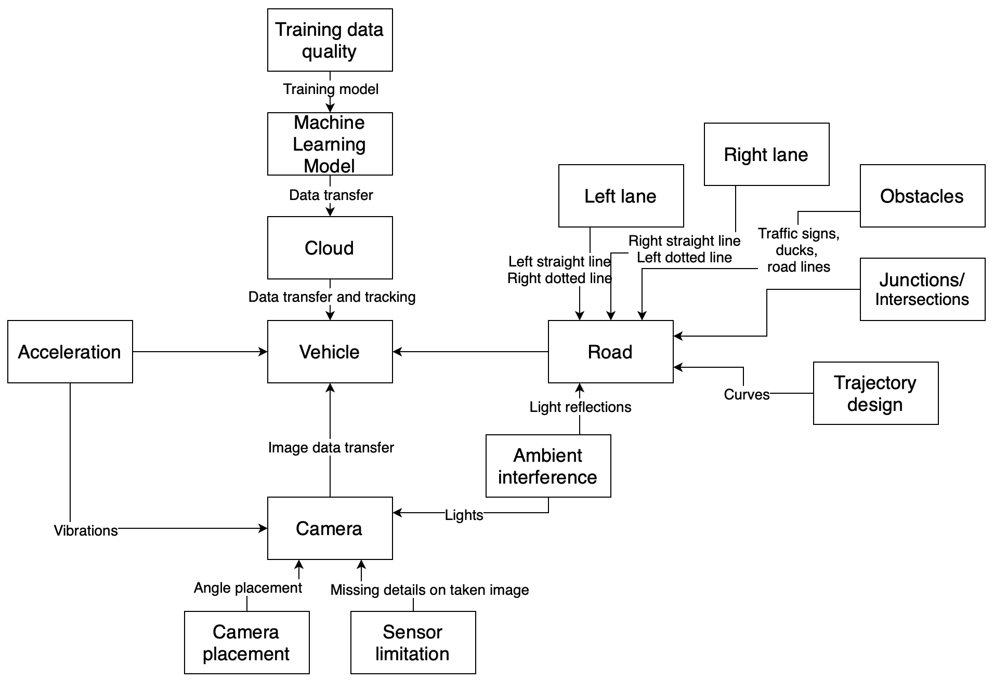
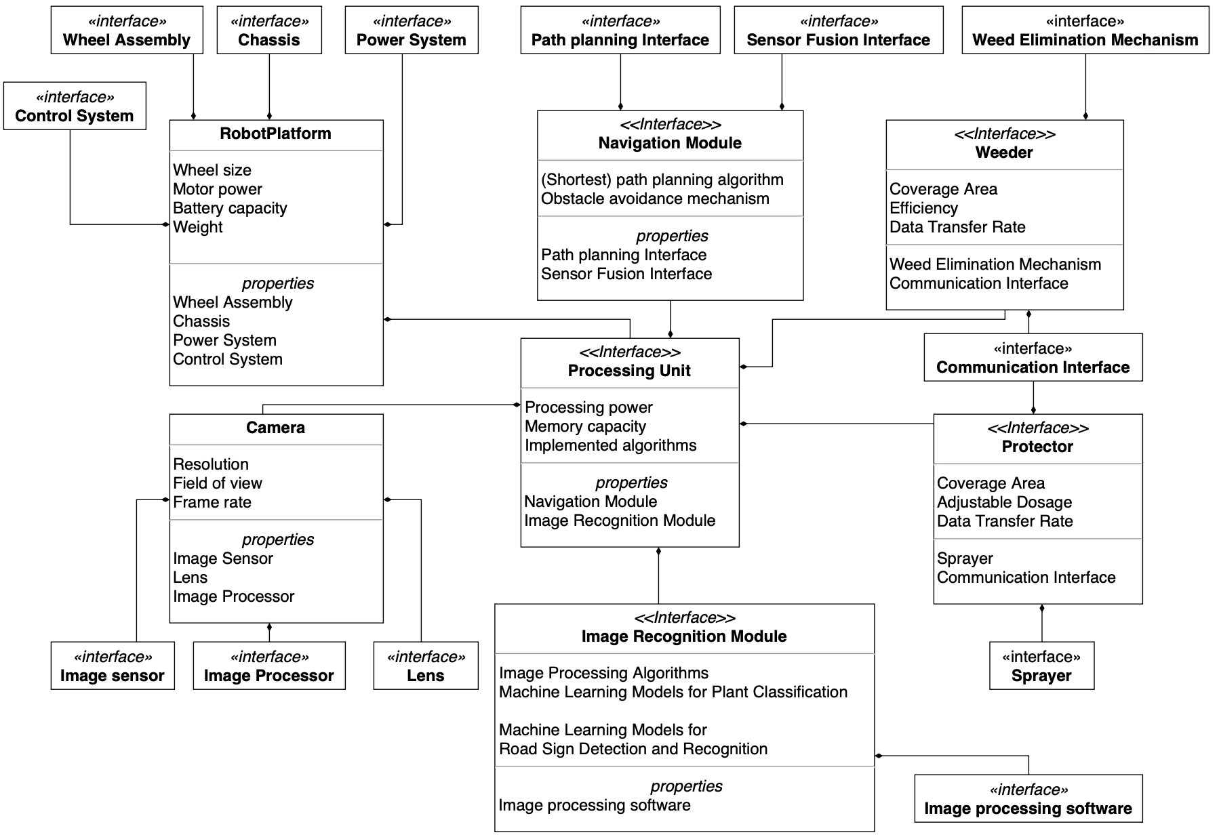

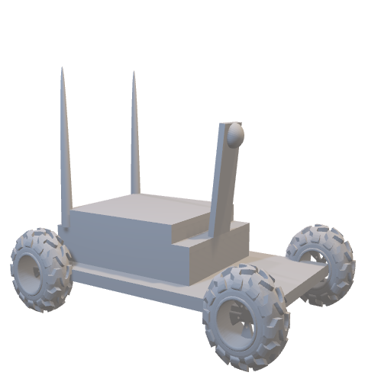
CONSENS Method Precision Farming
Summer School
Mechatronic Systems Engineering
Compact List of Requirements
Functions Diagram
Application Scenarios
Behaviour Diagram
Environment diagram
Active Structure Diagram
Authors:
Furkan Ali Yurdakul
Bruno Hyska
Ian Murnane
Elbek Bakiev
Zaur Gurbanli

Slide 2
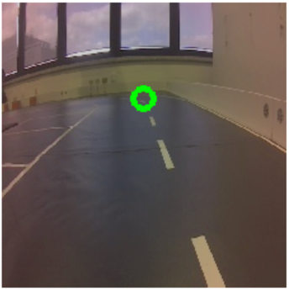
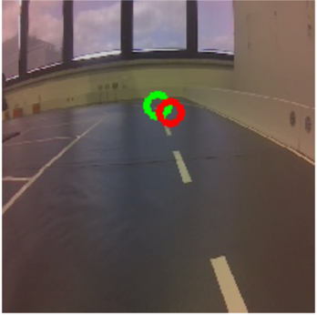
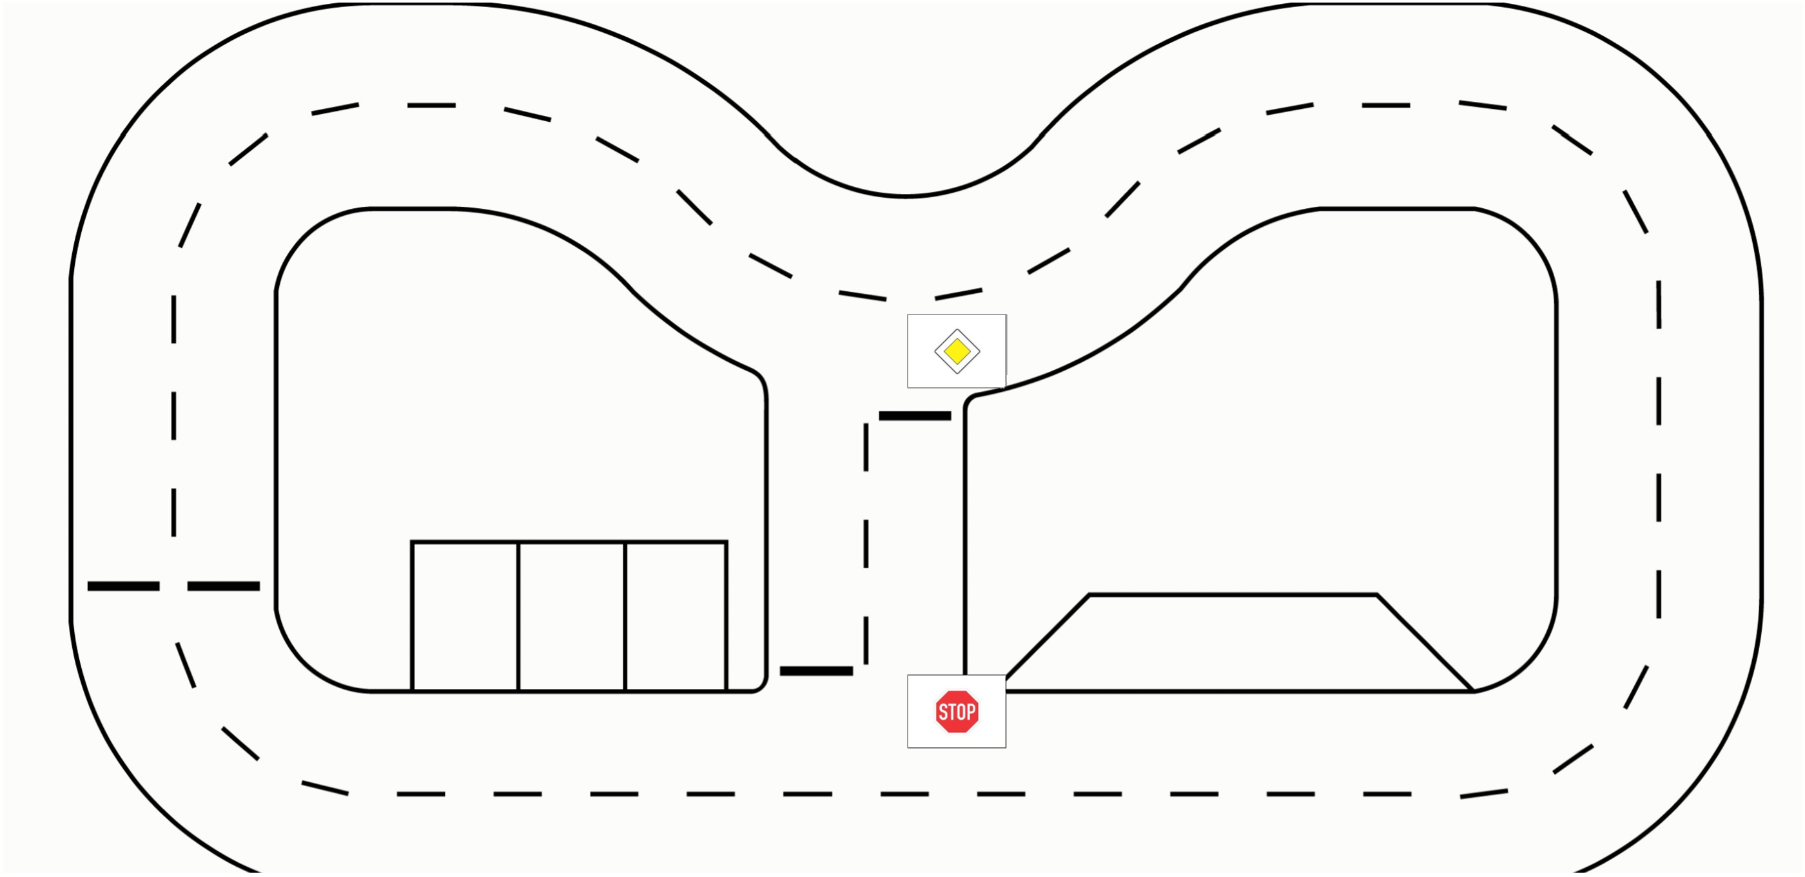
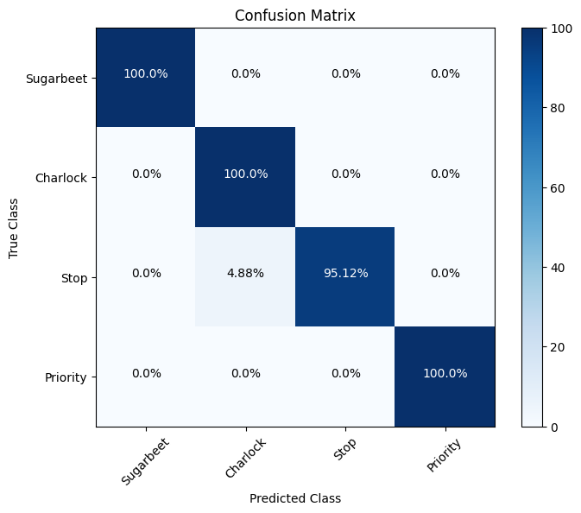
Cognitive Behaviour
Precision Farming
Summer School
Mechatronic Systems Engineering
Autonomous Driving - Model Training
Green: Target
Red: Prediction
 | ResNet-18 | ResNet-34
Model Depth | 18 layers | 34 layers
Dataset size | better with small datasets | better with large datasets
Complexity of the Road | better on less detailed road | better on detailed roads
Training time | less required | more required
Computational Resources | less required | more required
Training Accuracy
Signage – Image Classification
Authors:
Furkan Ali Yurdakul
Bruno Hyska
Ian Murnane
Elbek Bakiev
Zaur Gurbanli

Slide 3
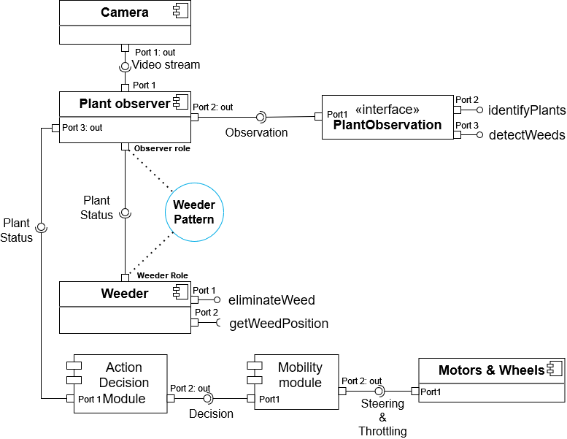
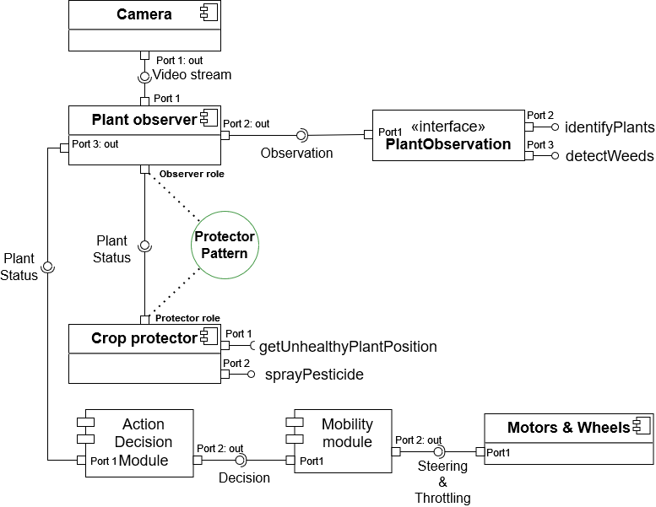
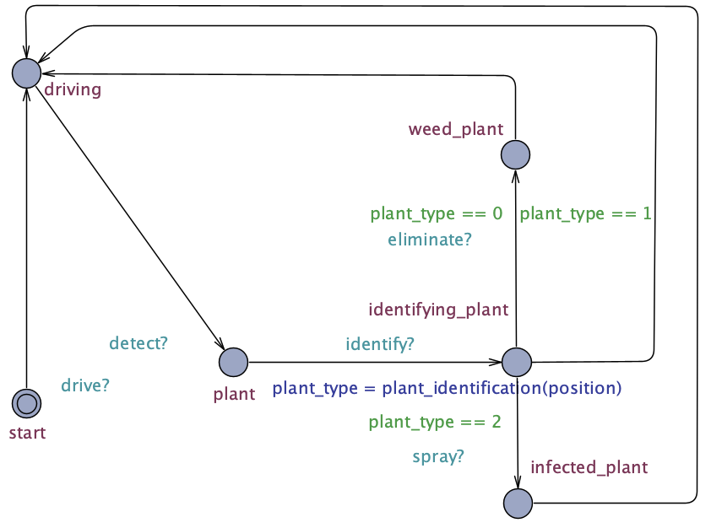
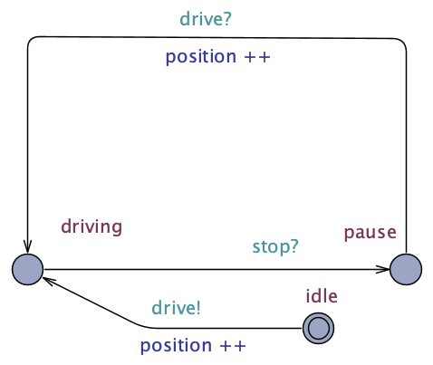
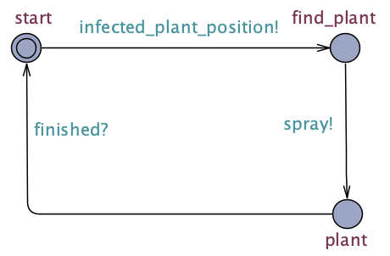
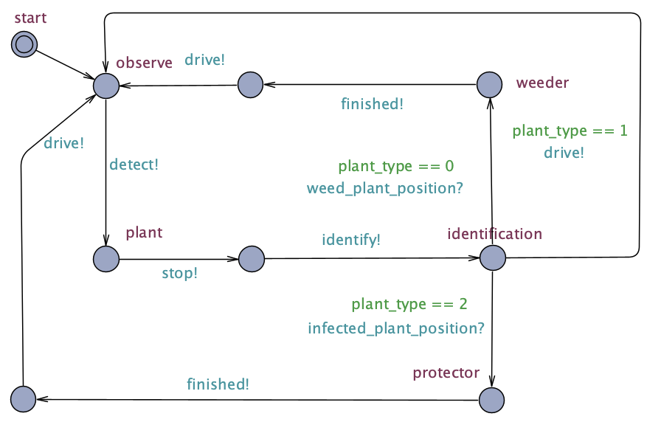
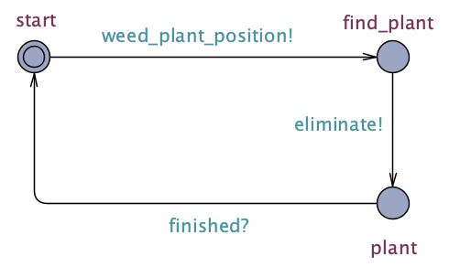
Mechatronic UML Precision Farming
Summer School
Mechatronic Systems Engineering
Component diagram
UPPAAL
Vehicle
Track
Protector
Observer
Weeder
Authors:
Furkan Ali Yurdakul
Bruno Hyska
Ian Murnane
Elbek Bakiev
Zaur Gurbanli

